Slide 1
Relations

Slide 2
Relations and Their Properties
Relations
Let A and B be sets. A binary relation from A to B is a subset of A × B.

Slide 3
Example
Let A be the set of students in your school, and let B be the set of courses.
Let R be the relation that consists of those pairs (a, b), where a is a student enrolled in course b.
For instance, if John and David are enrolled in CS518, the pairs
( John, CS518) and (David, CS518) belong to R.
If John is also enrolled in CS510, then the pair (John, CS510) is also in R.
However, if David is not enrolled in CS510, then the pair (David, CS510) is not in R.
Note that if a student is not currently enrolled in any courses there will be no pairs in R that have this student as the first element. Similarly, if a course is not currently being offered there will be no pairs in R that have this course as their second element.

Slide 4
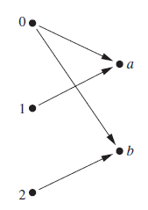
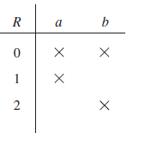
Graphical Representation
Let A = {0, 1, 2} and B = {a, b}. Then {(0, a), (0, b), (1, a), (2, b)} is a relation from A to B.
This means, for instance, that 0R a, but that 1R b. Relations can be represented graphically a

Slide 5
Relations on a Set
A relation on a set A is a relation from A to A.

Slide 6
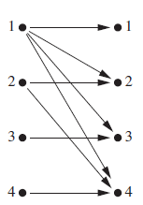
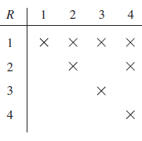
Example
Let A be the set {1, 2, 3, 4}. Which ordered pairs are in the relation R = {(a, b) | a divides b}?
Solution:
Because (a, b) is in R if and only if a and b are positive integers not exceeding 4 such that a divides b, we see that
R = {(1,1), (1, 2), (1, 3), (1, 4), (2, 2), (2, 4), (3, 3), (4, 4)}
graphically and in tabular

Slide 7
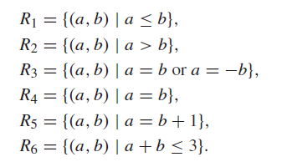
Example
Consider these relations on the set of integers:
Which of these relations contain each of the pairs (1, 1), (1, 2), (2, 1), (1,−1), and (2, 2)?
Solution:
The pair (1, 1) is in R1, R3, R4, and R6;
(1, 2) is in R1 and R6;
(2, 1) is in R2, R5, and R6;
(1,−1) is in R2, R3, and R6; and
finally, (2, 2) is in R1, R3, and R4.

Slide 8


Properties of Relations

Slide 9
Reflexive and Irreflexive
A relation R on the set A is irreflexive if for every a ∈ A, (a, a) ∈ R. That is, R is irreflexive if no element in A is related to itself.

Slide 10
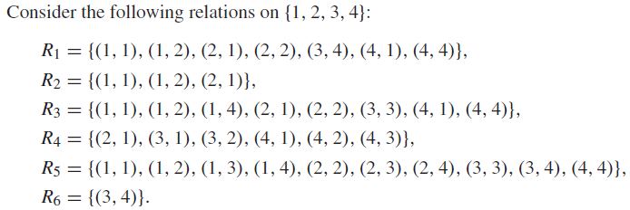

Example
Solution:
The relations R3 and R5 are reflexive because they both contain all pairs of the form (a, a), namely, (1, 1), (2, 2), (3, 3), and (4, 4).
The other relations are not reflexive because they do not contain all of these ordered pairs. In particular, R1, R2, R4, and R6 are not reflexive
because (3, 3) is not in any of these relations
R4 and R6 are irreflexive .

Slide 11
Is the “divides” relation on the set of positive integers reflexive?
Solution:
Because a | a whenever a is a positive integer, the “divides” relation is reflexive.
(Note that if we replace the set of positive integers with the set of all integers the relation is not reflexive because by definition 0 does not divide 0.)

Slide 12
Symmetric and Anti-symmetric

Slide 13
Example
Solution:
The relations R2 and R3 are symmetric.
For R2, both (2, 1) and (1, 2) are in the relation.
For R3, both (1, 2) and (2, 1) belong to the relation ,and (1, 4) and (4, 1) belong to the relation.
R4, R5, and R6 are all anti-symmetric.

Slide 14
Example
Is the “divides” relation on the set of positive integers symmetric? Is it anti-symmetric?
Solution: This relation is not symmetric because 1| 2, but 2 | 1.
It is anti-symmetric, for if a and b are positive integers with a |b and b |a, then a = b

Slide 15
Transitive

Slide 16
Example
Solution:
R4, R5, and R6 are transitive
R4 is transitive, because (3, 2) and (2, 1), (4, 2) and (2, 1), (4, 3) and (3, 1), and (4, 3)
and (3, 2) are the only such sets of pairs, and (3, 1), (4, 1), and (4, 2) belong to R4.
R5 and R6 are transitive.
R1 is not transitive because (3, 4) and (4, 1) belong to R1, but (3, 1) does not.
R2 is not transitive because (2, 1) and (1, 2) belong to R2, but (2, 2) does not.
R3 is not transitive because (4, 1) and (1, 2) belong to R3, but (4, 2) does not. c.

Slide 17
Example
Is the “divides” relation on the set of positive integers transitive?
Solution:
Suppose that a divides b and b divides c.
Then there are positive integers k and l such that b = ak and c = bl.
Hence, c = a(kl), so a divides c.
It follows that this relation is transitive

Slide 18
Exercise 9.1
3
11

Slide 19
Representing Relations

Slide 20

Representing Relations Using Matrices
A relation between finite sets can be represented using a zero–one matrix. Suppose that R is a relation from A = {a1, a2, . . . , am} to B = {b1, b2, . . . , bn}. (Here the elements of the sets A and B have been listed in a particular, but arbitrary, order. Furthermore, when A = B we use the same ordering for A and B.) The relation R can be represented by the matrix MR = [m_{ij} ], where

Slide 21

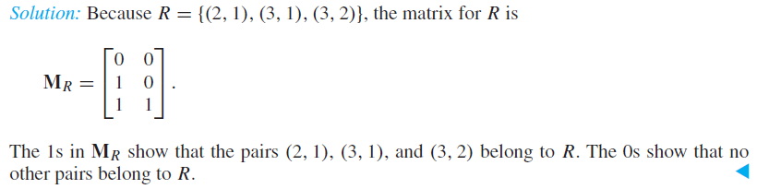
Example

Slide 22
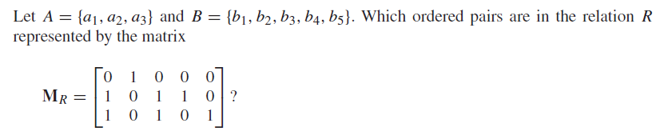

Example

Slide 23
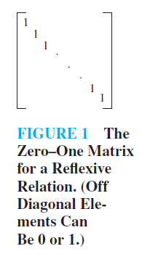
Reflexive
The matrix of a relation on a set, which is a square matrix, can be used to determine whether the relation has certain properties.
Relation R on A is reflexive if (a, a) ∈ R whenever a ∈ A. Thus, R is reflexive if and only if (ai, ai) ∈ R for i = 1, 2, . . . , n. Hence, R is reflexive if and only if mii = 1, for i = 1, 2, . . . , n. In other words, R is reflexive if all the elements on the main diagonal of M_{R} are equal to 1

Slide 24
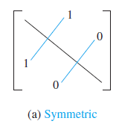
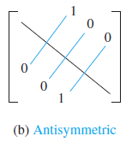
Symmetric and Anti Symmetric
R is symmetric if and only if mji = 1 whenever mij = 1. This also means mji = 0 whenever mij = 0.
The relation R is antisymmetric if and only if (a, b) ∈ R and (b, a) ∈ R imply that a = b.
Consequently, the matrix of an antisymmetric relation has the property that if mij = 1 with i = j , then mji = 0. Or, in other words, either mij = 0 or mji = 0 when i = j .

Slide 25
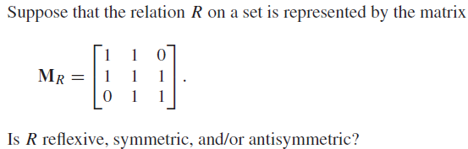
Example

Slide 26
Representing Relations Using Diagraphs

Slide 27
A directed graph, or digraph, consists of a set V of vertices (or nodes) together with a set E of ordered pairs of elements of V called edges (or arcs).
The vertex a is called the initial vertex of the edge (a, b), and the vertex b is called the terminal vertex of this edge.
a
b

Slide 28
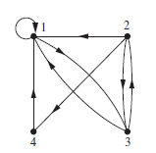
The directed graph of the relation
R = {(1, 1), (1, 3), (2, 1), (2, 3), (2, 4), (3, 1), (3, 2), (4, 1)}
on the set {1, 2, 3, 4}

Slide 29
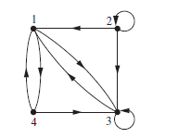
What are the ordered pairs in the relation R represented by the directed graph shown in Figure?
Solution:
R = {(1, 3), (1, 4), (2, 1), (2, 2), (2, 3), (3, 1), (3, 3), (4, 1), (4, 3)}.
Each of these pairs corresponds to an edge of the directed graph, with (2, 2) and (3, 3) corresponding to loops.

Slide 30
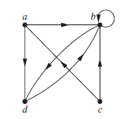
Draw the directed graph with vertices a, b, c, and d, and edges (a, b), (a, d), (b, b), (b, d), (c, a),(c, b), and (d, b)

Slide 31
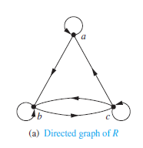
Determine whether the relations for the directed graphs shown in Figure are reflexive, symmetric, antisymmetric, and/or transitive.
Because there are loops at every vertex of the directed graph of R, it is reflexive.
R is neither symmetric nor antisymmetric because there is an edge from a to b but not one from b to a, but there are edges in both directions connecting b and c.
Finally, R is not transitive because there is an edge from a to b and an edge from b to c, but no edge from a to c.

Slide 32
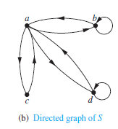
Determine whether the relations for the directed graphs shown in Figure are reflexive, symmetric, antisymmetric, and/or transitive.
Because loops are not present at all the vertices of the directed graph of S, this relation is not reflexive.
It is symmetric and not antisymmetric, because every edge between distinct vertices is accompanied by an edge in the opposite direction.
It is also not hard to see from the directed graph that S is not transitive, because (c, a) and (a, b) belong to S, but (c, b) does not belong to S.

Slide 33
Exercise 9.3
1
2
3
7
19
21
23
25
31

Slide 34

Equivalence Relations
A relation on a set A is called an equivalence relation if it is reflexive, symmetric, and transitive.

Slide 35
Exercise 9.5
1

